Slide 1
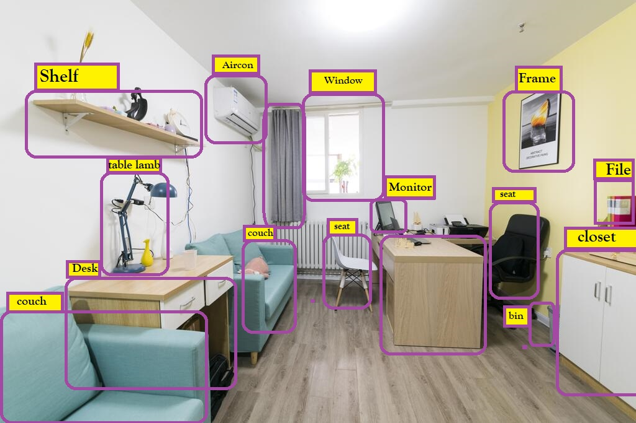
Real Time object detection with tfjs

Slide 2

PILLAI COLLEGE OF ENGINEERING,
NEW PANVEL-410206 , A+ NAAC
Academic Year 2021 – 22
Name: Mr. Ashwin Pareparampil (B51)
Mr. Saad Edroos(B17)
Mr. Adnan Kazi(B29)
Ms. Rahila Kable(B26)
Class: B.E (Computer Science)
College: Pillai college of Engineering
Semester: VI
Name of the Guide: Prof. Tejali Mhatre

Slide 3
OUTLINE
Abstract
Introductions
Problem Statement
Literature Survey
Object Detection Workflow
System Architecture
Hardware and Software Requirement
Application
Result
Conclusion and Future Scope
Reference and Acknowledgment

Slide 4
ABSTRACT
In recent years, deep learning has been used in image classification, object tracking, action recognition and scene labeling. Traditionally, Image Processing techniques were used to solve any Computer Vision problems occurred in an artificial intelligence system. However, in real-time identification, image processing cannot be used. This is where Deep Learning concepts are applied. We built a simple Convolutional Neural Network for object detection. The model is trained and multiple test cases are implemented in the TensorFlow environment so as to obtain accurate results.

Slide 5
INTRODUCTION
The applications and widespread use of machine learning algorithms have made a significant change in the way we perceive computer vision problems.
With the introduction of deep learning into the field of image classification, the dynamics of real-time object detection have faced a great impact.
The model is trained to detect objects in real-time. This can be best achieved through a universal and open source library-TensorFlow (TF).

Slide 6
PROBLEM STATEMENT
The development of the algorithm for object detection and identification is a big challenge for this system.
The challenges faced in object detection and tracking is variation of height and the body shape.
System may fail in case of object size is too small or distance should be very far from the system.
One of the major problem in object detection and identification is image classification to determine the class of the images from the specified Location.

Slide 7
LITERATURE SURVEY
SR NO. | NAME | PROPOSED MODEL | DESCRIPTION | YEAR | ADVANTAGES | DISADVANTAGES
1 | Xu,N. et al. | Proposed model for adaptive brightness changes | In this research observed that YOLO is much better then other method of detectors. | 2019
2 | Cadoni, M. et al | Novel image-based approach for identifying the objects | Recognition rates hits 91.17 percent at rank one, which compare favorably with the 81.75 recognition rate achieved through a competitive Bag-of-Words-based Process | 2019
3 | Jian Bang & Danni Cheng | Detecting and identifying vehicle part | Capture the image of vehicles includes the part of the vehicles. | 2018

Slide 8
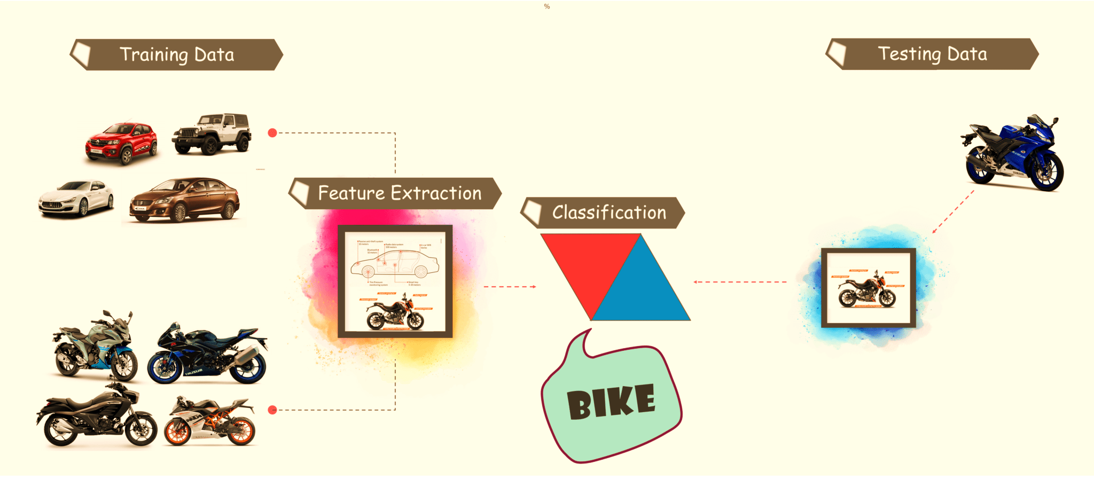
OBJECT DETECTION WORKFLOW
Every Object Detection Algorithm has a different way of working, but they all work on the same principle
Feature Extraction: They extract features from the input images at hands and use these features to determine the class of the image. Be it through MATLAB, Open CV, Viola Jones or Deep Learning.

Slide 9
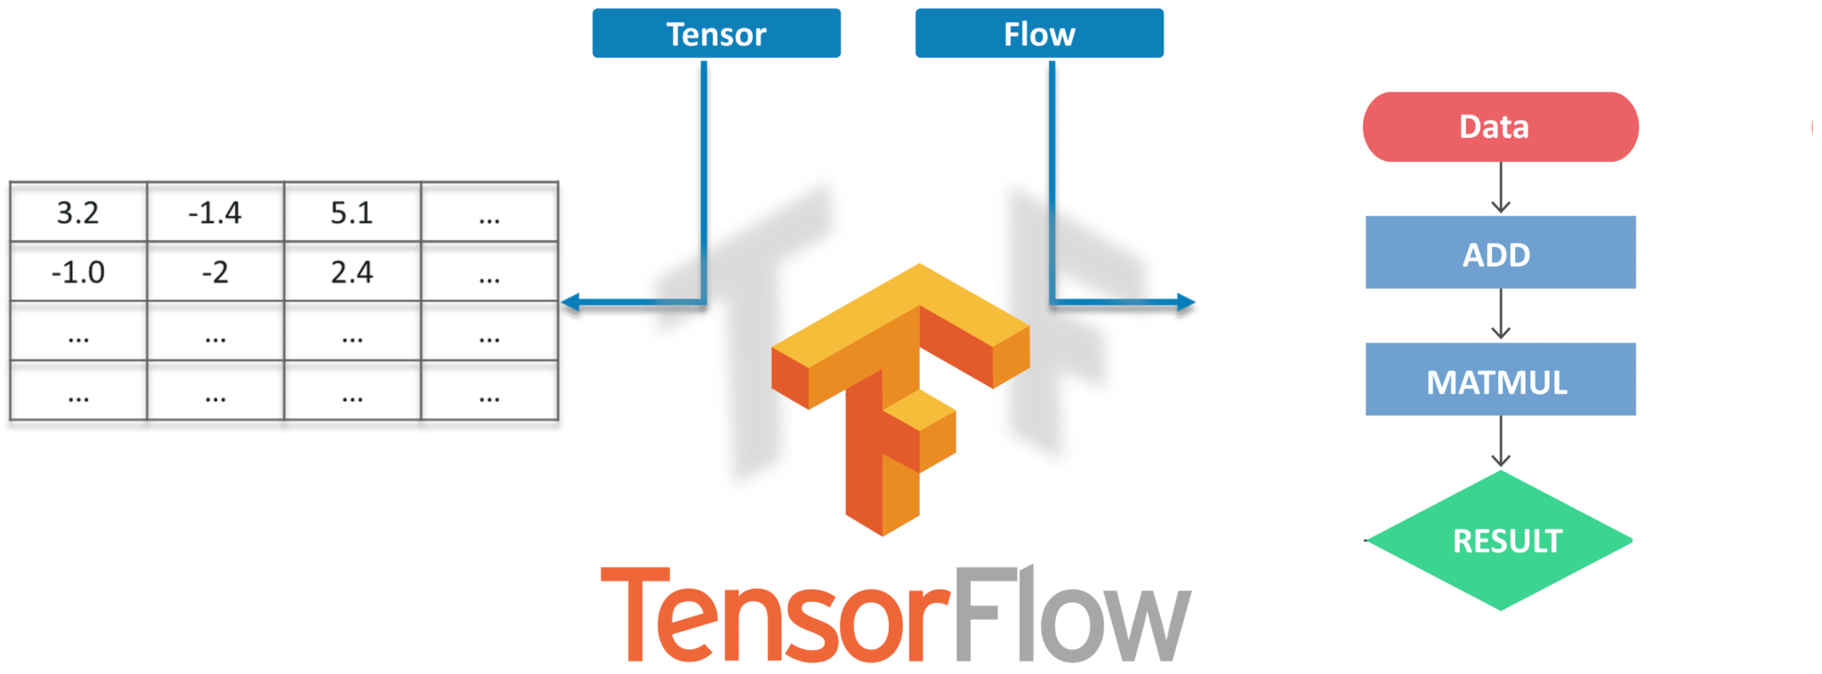
SYSTEM ARCHITECTURE
What is TensorFlow?
Google’s Open Source Machine Learning Framework
Tensors are just multidimensional arrays
extension of 2-dimensional tables

Slide 10
SYSTEM ARCHITECTURE
OBJECT DETECTION (COCO-SSD)
Detects objects defined in the COCO dataset
Large-scale object detection
Segmentation
Captioning dataset
Does not require you to know about machine learning
Takes input as any browser-based image elements
Returns an array of bounding boxes with class name and confidence level

Slide 11
USAGE
There are two main ways to get this model in your JavaScript project: via script tags or by installing it from NPM and using a build tool like Parcel, WebPack, or Rollup.
via NPM
// Note: Require the cpu and webgl backend and add them to package.json as peer dependencies.
require('@tensorflow/tfjs-backend-cpu');
require('@tensorflow/tfjs-backend-webgl');
const cocoSsd = require('@tensorflow-models/coco-ssd');
(async () => {
const img = document.getElementById('img');
// Load the model.
const model = await cocoSsd.load();
// Classify the image.
const predictions = await model.detect(img);
console.log('Predictions: ');
console.log(predictions);
})();

Slide 13
Applications Of Object Detection
Facial Recognition
People Counting
Industrial Quality Check
Self Driving Cars
Security

Slide 14
RESULT

Slide 15
CONCLUSION

Slide 16
REFERENCES
M. Cadoni, A. Lagorio, and E. Grosso, “Incremental models based on features persistence for object recognition.” Pattern Recognition Letters, vol. 122, pp. 38-44, 2019
N, Xu, C. Huo, and C. Pan, “Adaptive Brightness Learning for Active Object recognition.” ICASSP 2019-2019 IEEE International Conference on Acoustics, Speech And Signal Processing(ICASSP), pp. 2161-2166, 2019.
S. Brahimi, N. B. Aoun, and C. B. Amar, “Boosted Convolutional Neural Network for object recognition at large scale,” NeuroComputing, vol.330,pp. 337-354, 2019
W. Fang, Y. Ding, F. Zhang, and V. s. Sheng, “DOG: A new background removal for object recognition from images,” Neurocomputing, vol. 361,pp. 85-91, 2019.

